Slide 1

Android Development
SAX/XML parsing
Final Project thoughts

Slide 2
Introduction to parsers
The word parser comes from compilers
In a compiler, a parser is the module that reads and interprets the programming language.

Slide 3
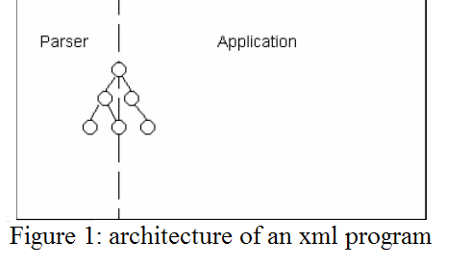
Introduction to Parsers
In XML, a parser is a software component that sits between the application and the XML files.

Slide 4
Introduction to parsers
It reads a text-formatted XML file or stream and converts it to a document to be manipulated by the application.

Slide 5
Well-formedness and validity
Well-formed documents respect the syntactic rules.
Valid documents not only respect the syntactic rules but also conform to a structure as described in a DTD (Document Type Definition).

Slide 6
Event-based
An event-based API reports parsing events (such as the start and end of elements) directly to the application through callbacks.
The application implements handlers to deal with the different events

Slide 7
Quick XML Review
XML – Wave of the future?
Method of representing data
Differs from HTML by storing and representing data instead of displaying or formatting data
Tags similar to HTML tags, only they are
user-defined
Follows a small set of basic rules
Stored as a simple ASCII text file, so portability is insanely easy

Slide 8
Quick XML Review
Syntax cont.
Every element has a start and end tag, with
optional attributes
<catalog … </catalog>
If an element does not contain any data (or elements) nested within, the closing tag can be merged with the start tag
<catalog

Slide 9
Quick XML Review
Syntax cont.
Elements must be properly nested
The outermost element is called the root element
An XML document that follows the basic syntax rules is called well-formed
An XML document that is well-formed and conforms to a DTD or Schema is called valid

Slide 10
Quick XML Review
Sample XML files
Catalog.xml

Slide 11
Catlog.xml
<?xml version="1.0"?>
<catalog library="somewhere">
<book>
<author>John Doe</author>
<title>Title 1</title>
</book>
<book>
<author>Phill Smith</author>
<title>His One Book</title>
</book>
<magazine>
<name>PC Mag</name>
<article page="17">
<headline>Second Headline</headline>
</article>
</magazine>
</catalog>

Slide 12
What is XML Parser?
A program or module that checks a well-formed syntax and provides a capability to manipulate XML data elements.
Navigate thru the XML document
Extract or query data elements
Add/delete/modify data elements

Slide 13
XML Parsing variants
DOM (Document Object Model).
Reads the whole document and builds DOM tree.
Simple API for XML = SAX
SAX is an event-based parsing method
reads an XML document, firing (or calling) callback methods when certain events are found (e.g. elements, attributes, start/end tags, etc.)
Pull parser (fast parsing available over SAX!!)

Slide 14
What is SAX (revisited)?
SAX (the Simple API for XML) is an event-based parser for xml documents.
The parser tells the application what is in the document by notifying the application of a stream of parsing events.
Application then processes those events to act on data.

Slide 15
SAX History
SAX 1.0 was released on May 11, 1998.
SAX is a common, event-based API for parsing XML documents.

Slide 16
Why SAX?
SAX parser scans an xml stream on the fly and responds to certain parsing events as it encounters them.
This is very different than digesting an entire XML document into memory.
Faster processing in Java for large XML files then DOM processing as it requires less memory.

Slide 17
Why SAX?
Event-based interface consumes fewer resources than an object-based one
With an event-based interface, the application can start processing the document as the parser is reading it

Slide 18
Limitations of SAX
With SAX, it is not possible to navigate through the document as you can with a DOM.
The application must explicitly buffer those events it is interested in.

Slide 19
SAX API
Parser events are similar to user-interface events such as ONCLICK (in a browser) or AWT events (in Java).
Events alert the application that something happened and the application might want to react.

Slide 20
SAX API
Element opening tags
Element closing tags
Content of elements
Entities
Parsing errors

Slide 21
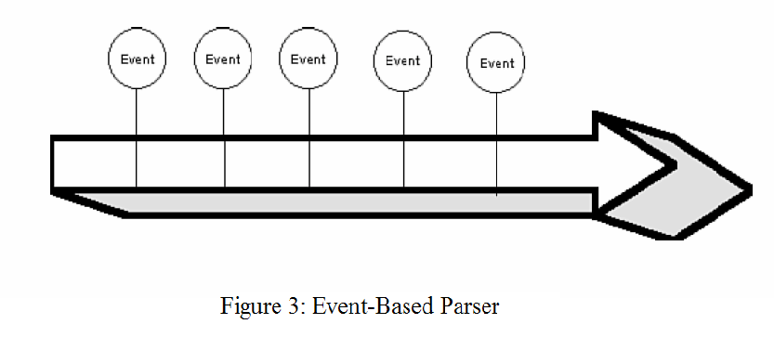
SAX API

Slide 22
SAX Example
<?xml version="1.0"?>
<doc>
<para>Hello, world!</para>
</doc>

Slide 23
SAX example
start document
start element: doc
start element: para
characters: Hello, world!
end element: para
end element: doc
end document

Slide 24
DOM vs. SAX Parsing?
Unlike DOM (Document Object Model), SAX does not store information in an internal tree structure
Because of this, SAX is able to parse huge documents (think gigabytes) without having to allocate large amounts of system resources
Really great if the amount of data you’re looking to process is relatively large (no waste of memory on tree)
If processing is built as a pipeline, you don’t have to wait for the data to be converted to an object; you can go to the next process once it clears the preceding callback method

Slide 25
DOM vs. SAX Parsing?
Most limitations are the programmer’s problem, not the API’s
SAX does not allow random access to the file; it proceeds in a single pass, firing events as it goes

Slide 26
Final project thoughts?
https://support.google.com/googleplay/android-developer/?hl=en&rd=1#topic=3450769
https://www.androidcentral.com/whats-new-android-google-io-2018
http://www.apple.com/ios/whats-new/
http://developer.android.com/support.html

Slide 27
Final project thoughts?
http://www.androidpit.com/en/android/forum/category/1004010/Android-Developer-Forum
https://android-developers.googleblog.com/

Slide 28
Final project thoughts?
Too Viral to handle???
http://www.cnn.com/2014/02/09/tech/flappy-bird-removed-from-app-stores/
https://www.quora.com/What-happened-to-the-Pok%C3%A9mon-GO-craze

